Slide 1
Writing Video Games with Ruby and Gosu
Austin on Rails – January 25, 2011
Mason Hale @masonhale
Garrett Hale

Slide 2

Introducing Gosu
A 2D game development library for Ruby and C++ on Mac OS X, Windows, Linux and iOS (iPhone, iPad)
http://www.gosulib.org
gem install gosu
Plays nicely with…
Chipmunk (physics engine)
http://code.google.com/p/chipmunk-physics/
TexPlay (image manipulation)
https://github.com/banister/texplay
OpenGL (hardware accelerated 3D)
RMagick (image manipulation)

Slide 3
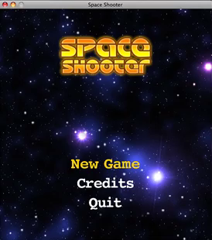
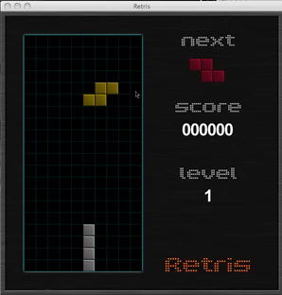
Gosu Examples
https://github.com/belen-albeza/space-shooter
https://github.com/angryrabbit/retris

Slide 4
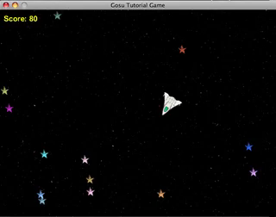
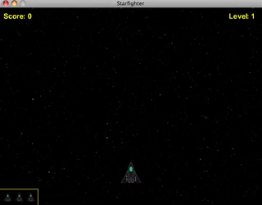
Gosu Tutorial
Ruby Tutorial
Starfighter Gosu Tutorial
https://github.com/masonhale/Starfighter-Gosu-Tutorial

Slide 5
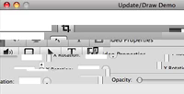
Gosu::Window Basics
require 'rubygems'
require 'gosu'
class GameWindow < Gosu::Window
def initialize
super(640,480,false)
@font = Gosu::Font.new(self, Gosu::default_font_name, 20)
@counter = 0
end
def update
@counter += 1
end
def draw
@font.draw(@counter, 0, 0, 1)
end
end
window = GameWindow.new
window.show
update
draw

Slide 6
Graphics
x
0
width
z
module ZOrder
Background = 0
Star = 1
Shot = 2
Ship = 3
UI = 4
end
y
height
Images are placed at x, y, z coordinates relative to top,left window corner

Slide 7
Colors
Colors are specified as 4-byte hexadecimal string in the format
0xAARRGGBB
AA = alpha transparency (00-ff)
RR = red component (00-ff)
GG = green component (00-ff)
BB = blue component (00-ff)

Slide 8

Gosu::Image
@background_image = Gosu::Image.new(self,
"media/space.png", true)
@background_image.draw(0, 0, ZOrder::Background)
0xffff00ff (pure magenta)
is automatically keyed in BMP images
@ship_image = Gosu::Image.new(self, 'media/starfighter.bmp', false)
@ship_image.draw_rot(400, 360, ZOrder::Ship, 0)
TIP: always use draw_rot for sprites to center x, y coordinates

Slide 9
Gosu::Image.load_tiles
@star_anim = Gosu::Image::load_tiles(self,
”star.png”, 25, 25, false)
Given a “sprite” image, slices based on tile_height and tile_width, returns Array of Gosu::Image objects
img = @star_anim[(Gosu::milliseconds / 100) % @star_anim.size]
# rotated -90 degrees, scaled up 3x with color shift
# note that image is drawn centered at x,y instead of top,left
img.draw_rot(100, 340, ZOrder::Star,
-90, 0.5, 0.5, # angle, centr_x, center_y
3.0, 3.0, 0xff99dd33) # scale_x, scale_y, color

Slide 10

Gosu::Window
Gosu::Window
draw_quad #draw rectangle (with gradient)
draw_line # draw lines (with gradient)
x = 400
y = 220
draw_quad(x - 4, y, 0xffaa0000,
x + 4, y, 0xffaa0000,
x - 4, y + 20, 0xffaacc00,
x + 4, y + 20, 0xffaacc00, ZOrder::Shot)

Slide 11
User Input
class GameWindow < Gosu::Window
...
def button_down(id)
case id
when Gosu::KbEscape
close # exit on press of escape key
end
end
def button_up(id)
case id
when Gosu::KbA
@counter =0 # reset release of ‘A’
end
end
end

Slide 12
User Input
def update
if button_down?(Gosu::KbLeft) or button_down?(Gosu::GpLeft)
move_left
end
if button_down?(Gosu::KbRight) or button_down?(Gosu::GpRight)
move_right
end
if button_down?(Gosu::KbUp) or button_down?(Gosu::GpUp)
move_up
end
if button_down?(Gosu::KbDown) or button_down?(Gosu::GpDown)
move_down
end
end
TIP: use button_down? In update method for “press and hold” interactions

Slide 13
Gosu::Song
def initialize
...
@backmusic = Gosu::Song.new(self, "media/backmusic.m4a")
@backmusic.play(true)
end
def toggle_music
if @backmusic.playing?
@backmusic.pause
else
@backmusic.play(true)
end
end

Slide 14
Gosu::Sample
class BaseShot
def self.load_sound(window)
@fire_sound ||= Gosu::Sample.new(window, 'media/fire.ogg')
end
def initialize(window)
@window = window
@snd = self.class.load_sound(@window)
end
def play_sound
@window.play_sound( @snd, 0.5, 1.0)
end
end
TIP: vary the frequency and volume to get extra mileage from your sounds

Slide 15
Gosu::Sample
class GameWindow < Gosu::Window
def initialize
@sounds = []
...
end
def play_sound(sound, frequency = 1.0, volume = 1.0)
# play returns SampleInstance
@sounds << sound.play(frequency, volume)
end
def pause_sounds
@sounds.each {|snd| snd.pause if snd.playing? }
end
def resume_sounds
@sounds.each {|snd| snd.resume if snd.paused? }
end
end
TIP: capture SampleInstance to enable pause/resume of sounds

Slide 16
Collision Detection
module GameUtilities
# Determines if two objects collide given # their x,y coordinates and radii
def self.collide?(thing1, thing2)
dist = Gosu::distance(thing1.x, thing1.y, thing2.x, thing2.y)
dist < (thing1.radius + thing2.radius)
end
end
TIP: for more sophisticated collision detection checkout Chipmunk
http://code.google.com/p/chipmunk-physics/

Slide 17
Questions?
http://code.google.com/p/gosu/wiki/RubyReference

